Slide 1
A Learning Approach to Edge Caching with Dynamic Content Library in Wireless Networks
Xinruo Zhang ; Gan Zheng ; Sangarapillai Lambotharan ; Mohammad Reza Nakhai ; Kai-Kit Wong
Global Telecommunications (GLOBECOM), IEEE Conference 2019
Loughborough University(UK)

Slide 2






Introduction
Global mobile data traffic is experiencing an explosive growth.
The backhaul data rate demand between the base stations (BSs) and the core network incurred by such rapid traffic growth.
It has become the major revenue and technical bottlenecks for the network operators, especially during peak traffic periods.
Since a large portion of backhaul traffic is contributed by duplicate data transmission, caching popular contents such as video and social media that are repeatedly requested by users near the wireless network edge.
…
Requests
Backhaul
Link
Base station
Most approaches in the literature assume limited cache storage and perfect knowledge of time invariant content popularity distribution at BSs, and design content delivery , content placement as well as joint content placement and delivery strategies in various network scenarios

Slide 3
Introduction
However, the previous works simply ignore the fact that the contents can be dynamic over time: new contents are constantly introduced to the system and their popularity distributions may change over time.
This paper considers a non-stationary content library, where the content popularity may change over time and locations.
This paper propose a three-phase procedure at different time scales for joint content placement and delivery at a BS.
Phase I is the BS’s main cache update phase at off-peak times, where the cache unit is updated from the content server.
Phase II is the BS’s flexible cache update phase during peak traffic hours, where the flexible portion of cache unit can be more frequently updated with user’s cached new contents.
Phase III is the content delivery phase at individual time instances, where each content demand is satisfied from either the BS’s local cache or the content server with different serving rewards.

Slide 4
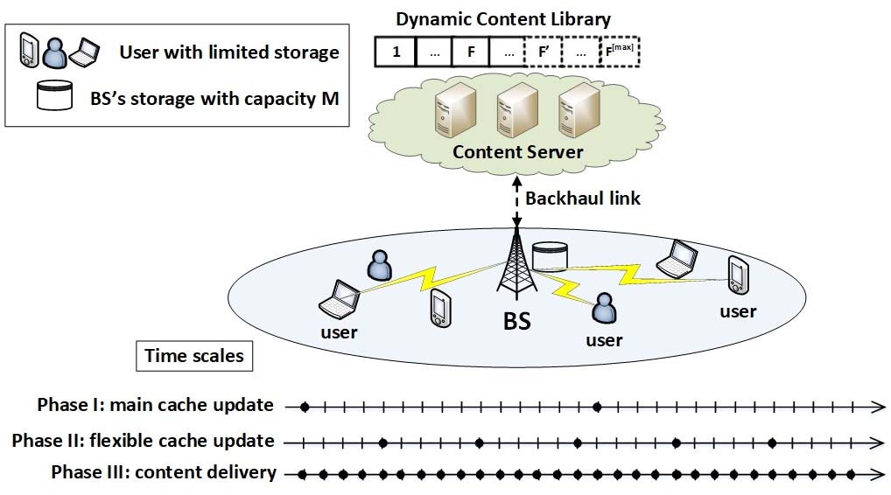
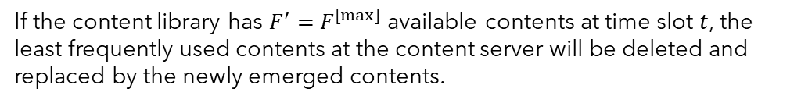

System model
To adaptively track the spatio-temporal variations of users’ content demands, a user-aided caching algorithm based on non-stationary bandit principle is developed to progressively optimize the caching policy at the BS, with the objective of maximizing the average weighted content delivery rate to the users.
System Scenario and Assumptions
$M$ : BS’s storage capacity
$K$ : Users. indexed by $ℒ_{u}=\{1, …, K\}$
$T$ : Discrete time slots $𝒯=\{1, …, T\}$
Non-stationary Content Library
$F$ : the initial contents in the content library
$F^{[max]}$ : the maximum numbers of contents in the content library
$$ℱ^{t}=\{1, …, F^{′}\}$$
The content library with individual content sizes of ${\{m_{f}\}}_{f∈ℱ^{t}}$ at the $t$-th time slot, where $F^{′}$ indicates the current number of contents in the library.
Time scales
If the content library has $F^{′}=$ $F^{[max]}$ available contents at time slot $t$, the least frequently used contents at the content server will be deleted and replaced by the newly emerged contents.
Fig. 1. Illustration of the system scenario and three-phase procedure at
different time scales for joint cache placement and content delivery.
Notes:
We consider a non-stationary finite content library at the content server, where new contents are constantly introduced into the system.

Slide 5
System model
New Contents at Users and Cache Unit at the BS:
Each user has a local cache memory and can only cache
one content at each time.
At the end of each time slot, the users update their cache memories with one of their respective requested contents.
In addition, newly emerged contents may be cached at some random users either via being generated by the local users themselves
The users are motivated to upload these potentially popular new contents to the BS for the incentive payment.
From the BS’s perspective, let us denote by$κ^{[user]} ∈[0, 1]$ the per-unit per-time-slot equivalent cost of the users’ uploading incentives.
Time scales
To fully exploit users’ cached contents, a portion with capacity of $ξM, ξ<1$, of the BS’s cache unit is allocated as the flexible cache memory that can be timely updated from users’ caches, while the remainder of the cache unit will be updated from the content server during off-peak traffic hours
Users’ Content Demands:
At each time slot $t , t∈𝒯$, user $u ,u∈ℒ_{u}$, may request up to $N_{u}^{t}$ number of different contents that are not cached by itself from the BS
according to some content popularity distribution ${\left\{θ_{u, f}^{t}\right\}}_{f∈ℱ^{t}}$ that is unknown to the BS.
Notes:
Either via ~중 하나를 통해
Via == ~를 통하여 through 같은

Slide 6
System model
Users’ Content Demands:
In addition to the temporal variability of the content popularity, we further consider the diversity of users’ content preferences as per their geographical locations.
Here we model the spatial diversity by circularly shifting the content popularity distribution of user u by Δu.
Let the content demands of user u at time $t$ be denoted by $d_{u}^{t}=\left\{d_{u1}^{t},…, d_{uf}^{t}, …{,d}_{uF^{′}}^{t}\right\},$ where the binary scalar
$d_{uf}^{t}∈\{0, 1\}$ indicates whether or the content $f$ is requested by user $u$ at time $t$, and ${\left\|d_{u}^{t}\right\|}_{0}≤ N_{u}^{t}$.
Time scales
Three-Phases Procedure:
We consider a three-phase procedure running concurrently at different time scales of $𝒯^{[main]}, 𝒯^{[flex]}$and $t∈𝒯$, for joint cache placement and content delivery in this paper.
In Phase I
I.e., for every τ time slots, the cache placement policy will be designed at the BS and the contents will be dispatched from the content server via backhaul link to update BS’s cache unit
Backhaul link

Slide 7

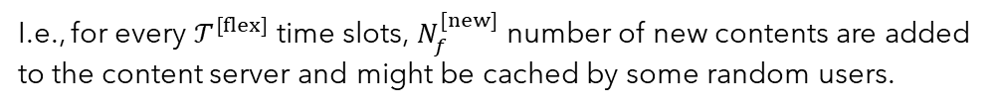
System model
Three-Phases Procedure:
In Phase II
I.e., for every $𝒯^{[flex]}$ time slots, $N_{f}^{[new]}$ number of new contents are added to the content server and might be cached by some random users.
Each user broadcasts its cached content directory to the BS, and the BS will then make a decision on whether or not to update its flexible cache with the users’ cached contents.
$$N_{f}^{[new]}$$
In Phase III
I.e., at each time slot $t$, $t∈𝒯$, the BS satisfies the instantaneous content requests of its users,
I.e., ${{\{d}_{u}^{t}\}}_{u∈ℒ_{u}}$, either by directly from its cache unit or by retrieving from the content server
with different per-unit gross serving gains of $π^{\left\{cache\right\}}$and $π^{\left\{server\right\}},$respectively.
To take into account the backhaul traffic offloading as well as to fully utilize the BS’s cache unit,
let us assume $π^{[cache]}$, $π^{[server]}$∈ [0, 1] and $π^{[server]}$< $π^{[cache]}$

Slide 8
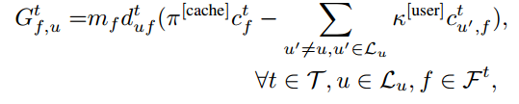


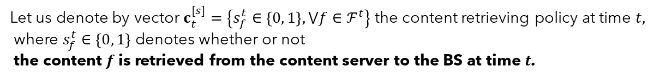

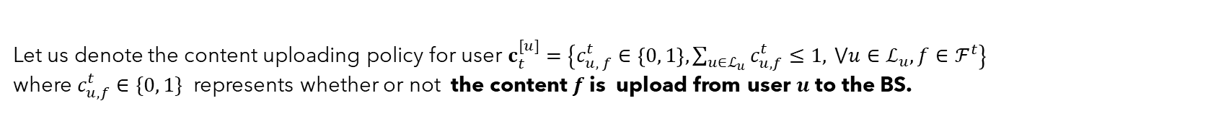





System model
Content Caching and Content Delivery:
[1]
Let us define the binary vector $c_{t}^{[p]}=\left\{c_{f}^{t}∈\left\{0, 1\right\}, ⋁f∈ℱ^{t}\right\}$ as the content placement policy at time $t$.
$c_{f}^{t}∈\left\{0, 1\right\}$ indicate that the content $f$ is cached and is not cached at the BS. (0 → not cached, 1 → cached)
$f$
$f$
$c_{f}^{t}$ =
1 0
[2]
Let us denote the content uploading policy for user $c_{t}^{[u]}=\left\{c_{u, f}^{t}∈\left\{0, 1\right\}, \sum_{u∈ℒ_{u}}{c_{u, f}^{t}≤1, }⋁u∈ℒ_{u}, f∈ℱ^{t}\right\}$
where $c_{u, f}^{t}∈\{0, 1\}$ represents whether or not the content $f$ is upload from user $u$ to the BS.
$c_{u, f}^{t}$ = 1
$f$
[3]
Let us denote by vector $c_{t}^{[s]}=\left\{s_{f}^{t}∈\left\{0, 1\right\}, ⋁f∈ℱ^{t}\right\}$ the content retrieving policy at time $t,$
where $s_{f}^{t}∈\left\{0, 1\right\}$ denotes whether or not
the content $f$is retrieved from the content server to the BS at time $t$.
$$s_{f}^{t}=1$$
$f$
Then, the net serving gain of the BS caching content $f$
and serving user u at time slot $t, t∈𝒯$, can be defined as
The net serving gain for BS retrieving content $f$ from the content server and serving user $u$ at time slot $t$, is given by
* $m_{f}$: the content library with individual content sizes
*$d_{uf}^{t}$ : whether or the content $f$ is requested by user $u$
*$κ^{[user]}$: the per-unit per-time-slot equivalent cost of the users’ uploading incentives.

Slide 9

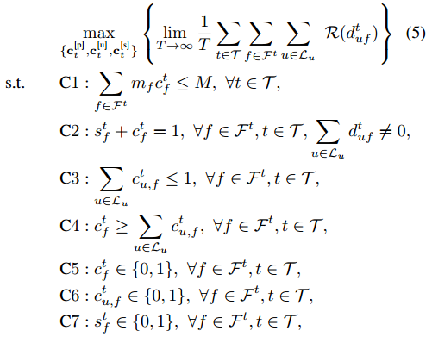




System model
$Ψ_{u}^{t}$ : channel gain between the BS and user $u$ at time slot $t$
$G_{f, u}^{t}$
from the BS’s cache unit with the net serving gain of
$P_{u}^{[Tx]}$ : transmit power from the BS to user $u$.
$G_{f, u}^{\left[s\right], t}$
from the content server with the net serving gain of
The instantaneous serving reward,
i.e., the weighted content delivery rate,
for serving user $u$ with content $f$ at time slot $t$ can be defined as
$σ_{u}^{2}$ : the variance of the additive white Gaussian noise at user $u$.
Problem Formulation
The objective of the BS is to design a joint caching policy {$c_{t}^{[p]}$, $c_{t}^{[u]}$, $c_{t}^{[s]}$} to offload as much traffic as possible from the
content server, while ensuring the quality of service (QoS) of the users.
The problem of interest can be formulated as the maximization of the long-term average reward of the network, i.e., the average weighted content delivery rate
(5)
Notes:
C1 : BS의 메모리 량을 넘어 설순 없다
C2 : 사용자의 컨텐츠 수요가 BS에 있든 Server에 있는 있어야한다.
guarantees that the user's content demands at each time slot will be satisfied either from the BS's cache unit or from server
C3 : 컨텐츠 f는 최대 1명의 사용자가 BS로 업로드 할 수 있다
C3 denotes that the content f can be uploaded from at most one local user to the BS.
C4 : 사용자로부터 업로드 된 콘텐츠가 BS의 캐시 유닛에 저장된다.
C4 indicates that the contents uploaded from the users will be stored at the BS’s cache unit.
C5 : BS내의 캐시 유무판단 해당 시점에 f의 컨텐츠
C6 : 사용자의 f컨텐츠 BS 업로드 가능 유무
C7 : 서버로 부터 f컨텐츠 BS 업로드 가능 유무
specify that the joint caching policy (1), (2), (3) are binary variables, respectively.

Slide 10
USER-AIDED LEARNING-BASED CONTENT CACHING STRATEGY
the problem in will be solved through a user-aided reinforcement learning-based three-phase procedure running concurrently at different time scales.
The main objective of the proposed caching algorithm is to progressively optimize the joint caching policy {$c_{t}^{[p]}$, $c_{t}^{[u]}$, $c_{t}^{[s]}$}
time slot by time slot, such that the long-term average reward.
the learning processes in Phase I, Phase II and Phase III of the proposed algorithm,
Phase I aim at tracking the variations in user demands in order to design {$c_{t}^{[p]}$} in constraints C1, C4 and C5 of problem (5) at every $𝒯^{[main]}$ time slots.
Phase II aim at design $c_{t}^{[u]}$in constraints C3 and C6 at every $𝒯^{[flex]}$ time slots.
Phase III aim at The content retrieving and delivery policy, i.e., $c_{t}^{[s]}$ in constraints C2 and C7, will be satisfied at each time slot $t$, $t$ ∈ $𝒯$
Let us consider a non-stationary generalization of the MAB problem that models a system of $F^{′}$actions whose expected rewards are independent and identically distributed over time with unknown means and may vary across time.
The objective of the agent in the MAB problem is to maximize the accumulated reward over time via exploring the environment to find profitable actions, while exploiting current knowledge to make the empirically best decisions among a set of actions.

Slide 11
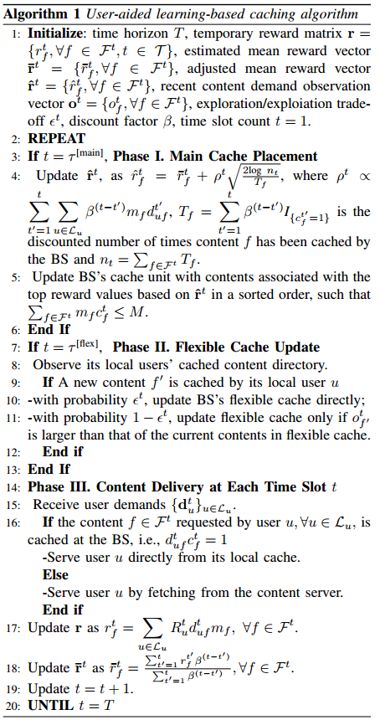


USER-AIDED LEARNING-BASED CONTENT CACHING STRATEGY
Temporary reward matrix $r=\{r_{f}^{t}, ⋁f∈ ℱ^{t}, t∈ 𝒯\}$
Estimated mean reward vector ${\overline{r}}^{t} = \{{\overline{r}}_{f}^{t}, ⋁f∈ ℱ^{t}\}$
Adjusted mean reward vector ${\hat{r}}^{t} = \{{\hat{r}}_{f}^{t}, ⋁f∈ ℱ^{t}\}$
Recent content demand observation $o^{t} = \{o_{f}^{t}, ⋁f∈ ℱ^{t}\}$
Exploration/exploitation $ε^{t}$
Discount factor $β$

Slide 12
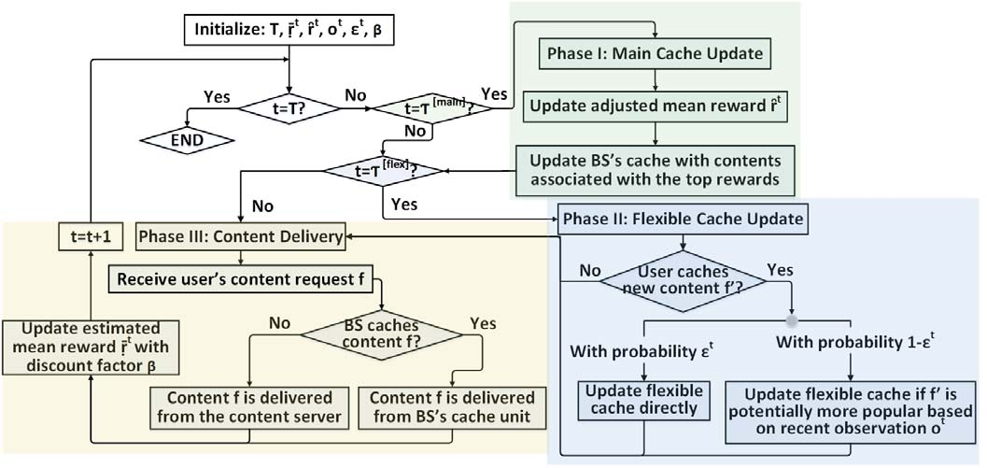

USER-AIDED LEARNING-BASED CONTENT CACHING STRATEGY
the BS can be regarded as the agent
$F^{′}$ actions correspond to the current library of $F^{′}$ contents at the content server

Slide 13


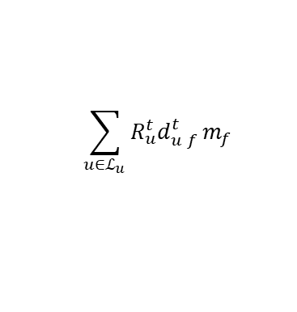

USER-AIDED LEARNING-BASED CONTENT CACHING STRATEGY
The user will be served from BS’s local cache with the top priority, and by retrieving from the content server with the least priority. Hence, the associated reward of action $f$, $f∈ ℱ^{t}$, can be defined as the aggregated content delivery rate for satisfying users’ content demand of $f$.
$$\sum_{u∈ℒ_{u}}{R_{u}^{t}d_{u f}^{t}}m_{f}$$
SIMULATIONS
Parameters
$K$ = 8
$F$= 100, $F^{[max]}$ = 150
Each content size varies as $m_{f}∈\{1, 2\}$
$M$ = 15, $ξ$= 0.2
$𝒯^{[main]}$ = 9, $𝒯^{[flex]}=3$,
$N_{f}^{[new]}$ = 3 → new contents will be added to the content library and might be cached by maximally 3 random users.,
The per-unit gross gains for the BS to serve its users directly from the local cache unit, and by retrieving contents from the content server are, respectively $π^{[server]}=1$ and $π^{[server]}=0.3$
The per-unit per-time-slot equivalent cost of users’ uploading incentives is $κ^{[user]}$ = 0.2
Popularity also follows a Zipf distribution.

Slide 14
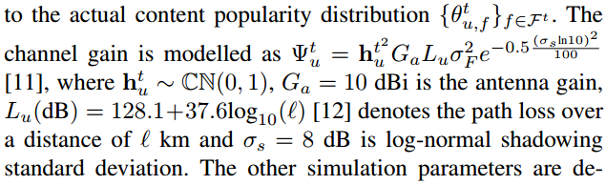
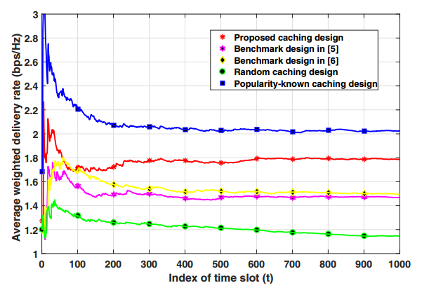


SIMULATIONS
the actual content preferences at the individual users that are unknown to the BS, where the circular shifts are $\left\{∆_{u}\right\}=\{0, 2, …, 14\}$.
Each user has up to $N_{u}^{t}=3$ number of different content requests at each time slot t according to the actual content popularity distribution
Exploration/exploitation $ε^{t}=0.8$
Discount factor $β=0.9$
Benchmark design[5] : estimates the content popularity distribution at the BS via the standard UCB algorithm.
Benchmark design[6] : learns the content popularity distribution at the BS via the combinatorial UCB algorithm.
Random caching design : A random caching design that randomly caches contents at the BS in Phase I regardless of user content demand.
Comparison of average reward for various caching designs.
Popularity-known caching design : The user-aided popularity-known caching design has perfect prior knowledge of actual content popularity distribution at the BS.
Notes:
UCB (Upper Confidence Bound Bandit)알고리즘 : 좋은 보상을 보이며 최적의 선택이 될 가능성이 있는 액션을 선택한다.
i=argmaxi​​ μi​+Pi​
[5] Learning-Based Content Caching and Sharing for Wireless Networks
[6] Learning-based optimization of cache content in a small cell base station

Slide 15
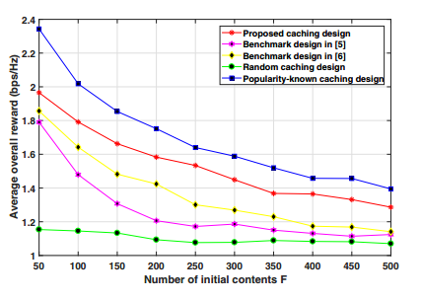
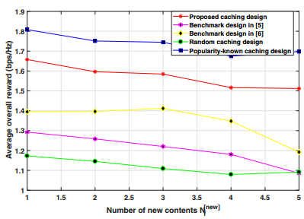
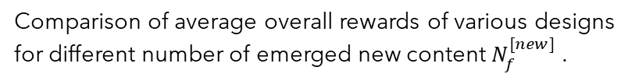
SIMULATIONS
Comparison of average overall rewards of various designs for different number of initial contents F.
Comparison of average overall rewards of various designs for different number of emerged new content $N_{f}^{[new]}$ .

